Slide 1
Internship Project
Name : Abhiyank Goyal
Program : T.Y. B-Tech, CSE, trimester - IX
PRN No. : 1032170652
Company : Simption Tech. Pvt. Ltd.
Project Title : Student Registration System
(School Software System)

Slide 2
Objectives
To Design online Student Registration System for Schools/Colleges which will ease the work of administrator to maintain the record of students and speed up the admission process of the students.
The project includes a sign-up form for the organization to assign the new administrator.
It consists of login form where admin can login.
It includes a form that allows admin to enter student details like:
Registration No.(which is automatically generated to remove duplicacy)
Select if Student is new/old
Class
Student name

Slide 3
Objectives
Gender
Date of admission
Bus service
Registration fees
Student’s address
Student photo
Student’s parent details
And other important details

Slide 4
Objectives
On click of the submit button, the page should be validated and after successful validation the data must be saved in the database.
The admin should be directed to the page where he can view the list of all the students registered
Each student should have options to:
Modify the details of the student
Delete the record of the student
Print receipt
Make Admission

Slide 5
Objectives
On click of modify option a page should open to where admin can make changes to the details of the student.
On click of delete option, the student record must be deleted from the list.
On click of Make Admission button a page must open showing the details of the student and options to upload various identification documents.
Once the documents are uploaded the user should be able to save the documents to the server and directed to the page where the list of all the students admitted is displayed. Here also each student has the options to modify, delete and print receipt.

Slide 6
Task Completed till date
Gathered project requirements
Details necessary for registering a student
Frameworks and technologies to be used
Designed a Sign-up and login page with the help of html5 and CSS.
Validated the Sign-up and login form with the help of JavaScript and server side language PHP using MySQL database.
Designed a Registration Form with the help of html5 and CSS.

Slide 7
Task Completed till date
Persisted the Student details in the MySQL database using PHP and performed validation using JavaScript. Generated unique registration for each new student.
Designed the students list page which consists a list of all the students registered and given options to modify the details, make admission, print receipt and delete the record to each student.
Implemented functionality to allow admin to modify, make admission and delete the record of the registered student.

Slide 8
Task Completed till date
Designed the page to modify the student details and performed the update query in the database using PHP.
Designed and styled a page to upload various documents required for the admission.
Stored the uploaded documents at the server side using JavaScript and PHP.
Designed and styled a page of admitted students which shows the list of all the students admitted. It has options to modify, delete the record of the student and print the admission fee receipt.

Slide 9
Task Completed till date
All the pages are given the navigation menu so that admin can navigate between different pages.
Below are the screenshots of the work:

Slide 10
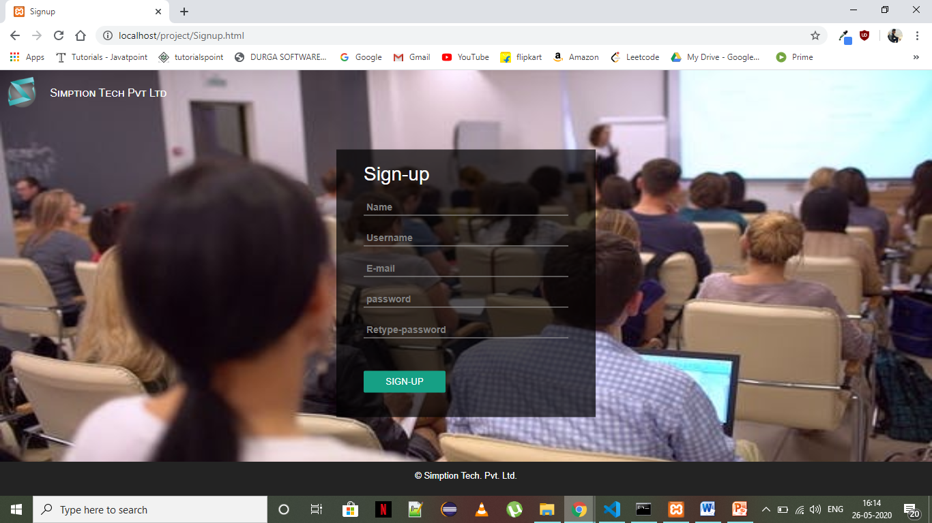
Sign-Up Page

Slide 11
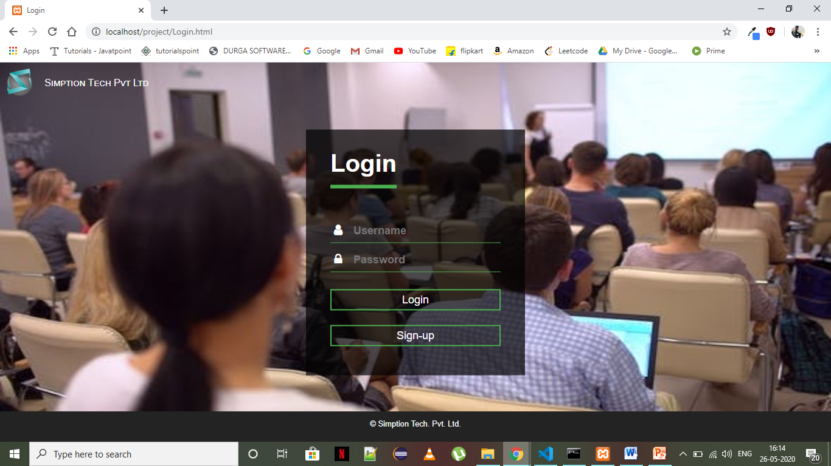
Login Page

Slide 12
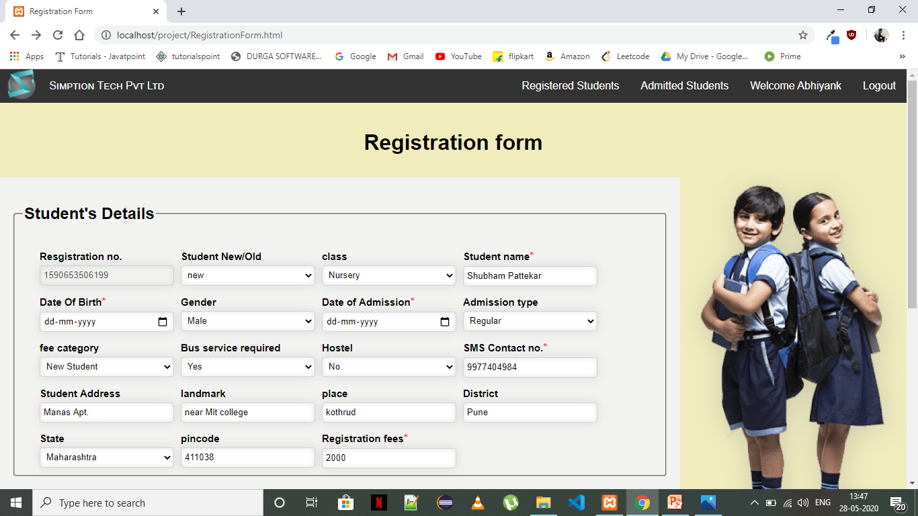
Registration Form

Slide 13
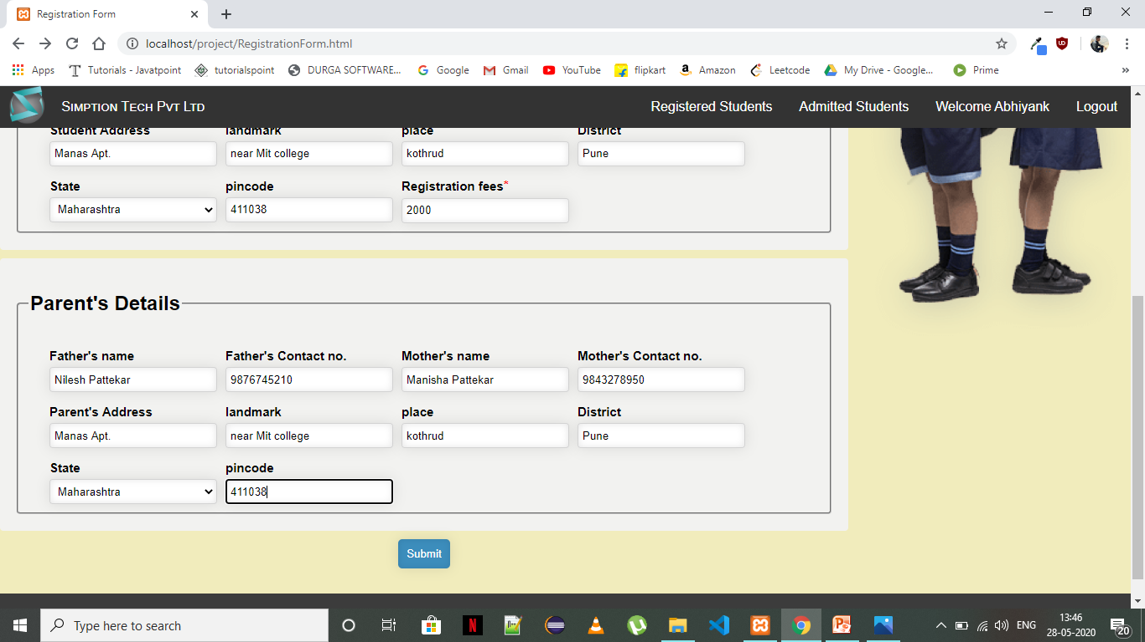

Slide 14
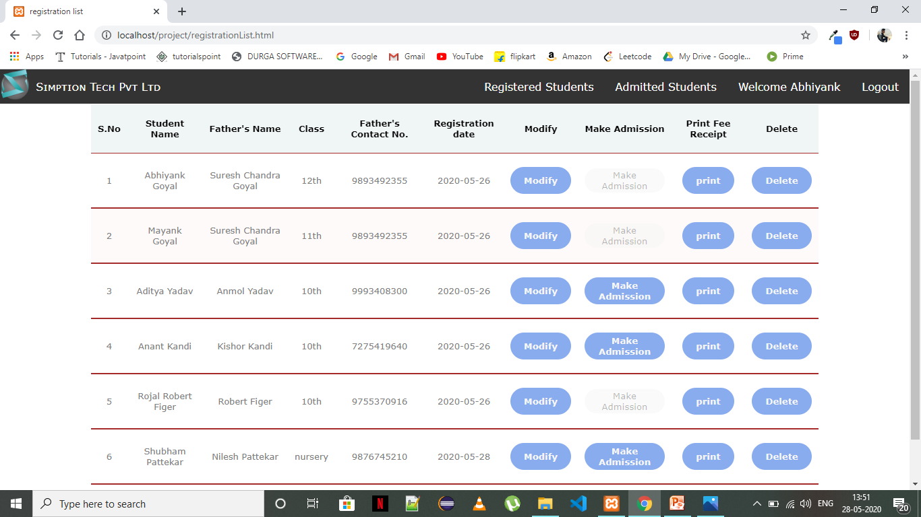
Registered Students list page

Slide 15

Update Student Details page

Slide 16
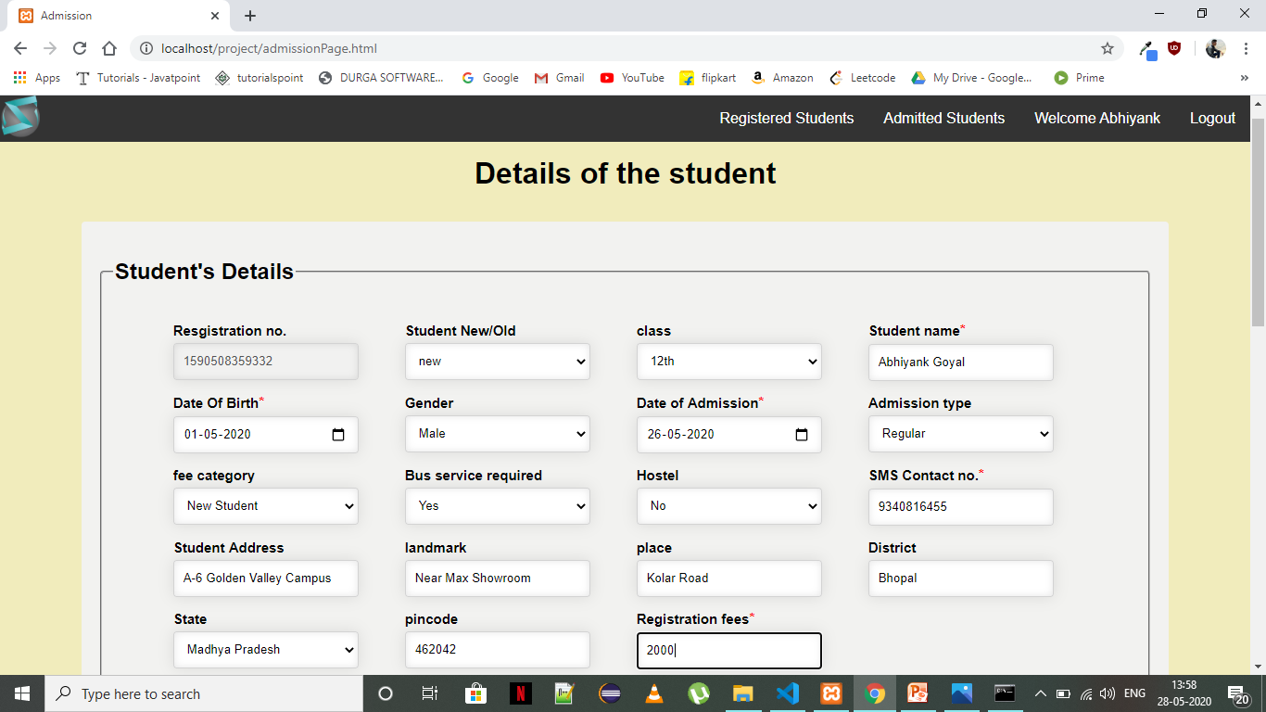
Documents upload page

Slide 17
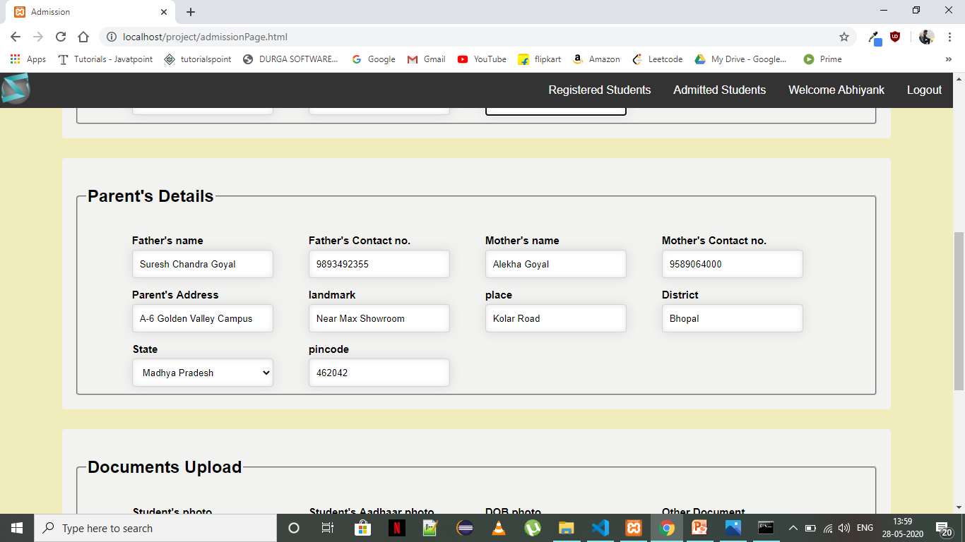

Slide 18
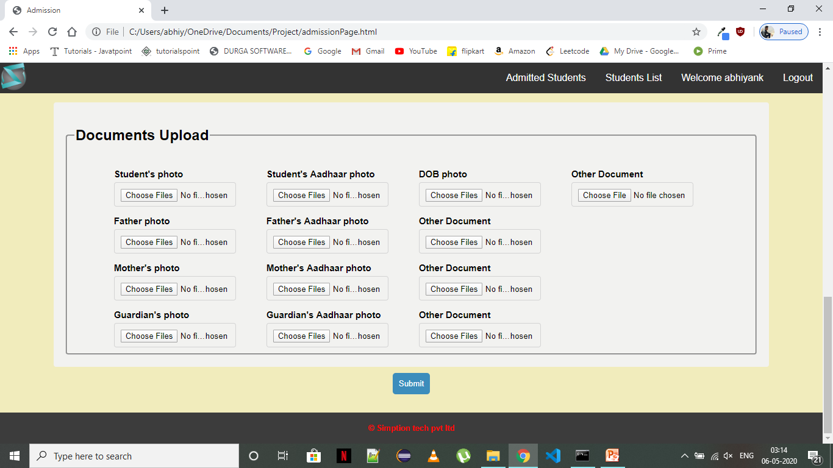

Slide 19
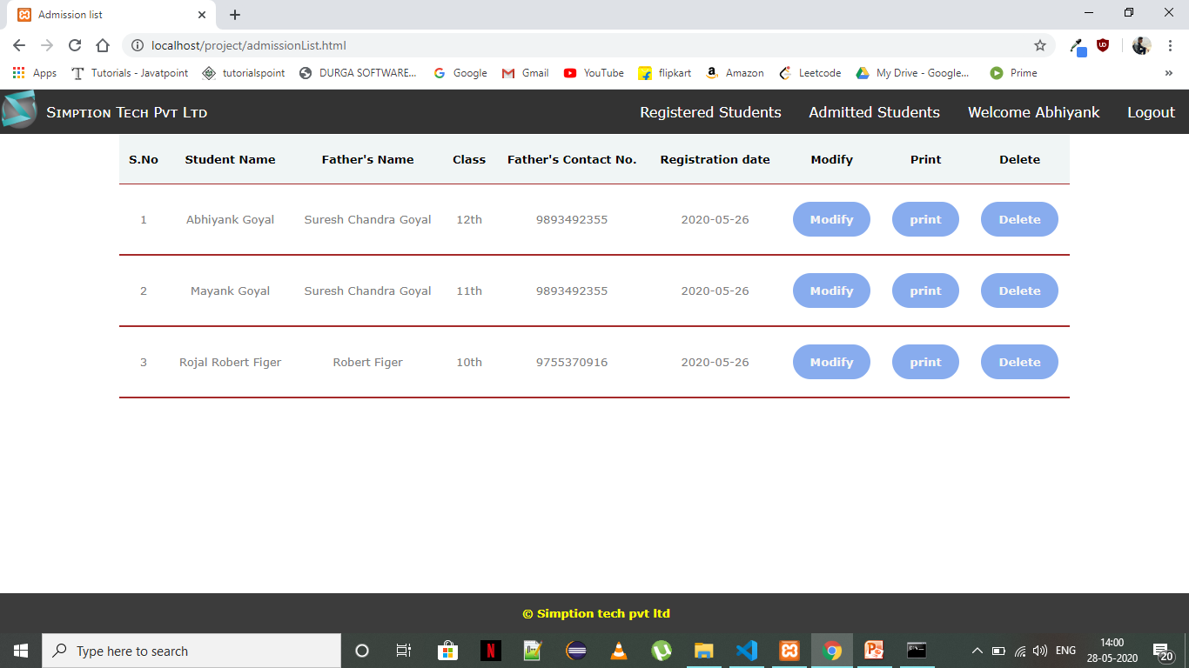
Admitted Students page

Slide 20
Key Learning's till date
Understanding of attributes required to register a student or make an admission for him.
Able to use html5 to design structure of a given web application
Using CSS to style the web application
Understanding how CSS helps in creating responsive web design.

Slide 21
Key Learning's till date
Training on JavaScript.
learned how to describe functionality of the web pages through JavaScript.
Learned how to apply form validation using JavaScript.
Learned to use local storage and session storage of the browser to store data and use that data.

Slide 22
Key Learning's till date
Learned the server side language PHP.
Learned to make data persistent in MySQL database PHP.
Learned the use of AJAX to make data exchange between the back-end and the front end.

Slide 23
Thank You

